Slide 1

Search Driven Apps
with the Elastic Stack
Notes:
Joe Zack, long time dev, podcaster
Talking about search driven apps, focus on Elasticsearch and the Elastic Stack…
Tell ya bout:
Define the problem
How Elastic solves it
Demonstrate 3 types of apps

Slide 2
The problem?
Google servers 40k searches…per second
Amazon sells over 500M products
Splunk indexes 100’s of TB per day
Notes:
Search is a core tenet of the modern day internet experience.
Google obviously, but think about how important search is to other experiences: Cortana, Spotlight, Alexa
You can hardly use the telephone, listen to music, buy underwear, or even watch “tv” without some sort of search. Imagine explaining that to your grandparents grandparents!
But…we humans aren’t very good at it.
We type things wrong, and a lot of the time we don’t know the name of the thing!
Tons of data: 5B videos watched on YouTube every day: https://merchdope.com/youtube-statistics/
How are these services doing it?
https://ardorseo.com/blog/how-many-google-searches-per-day-2018/
https://www.scrapehero.com/many-products-amazon-sell-january-2018/

Slide 3
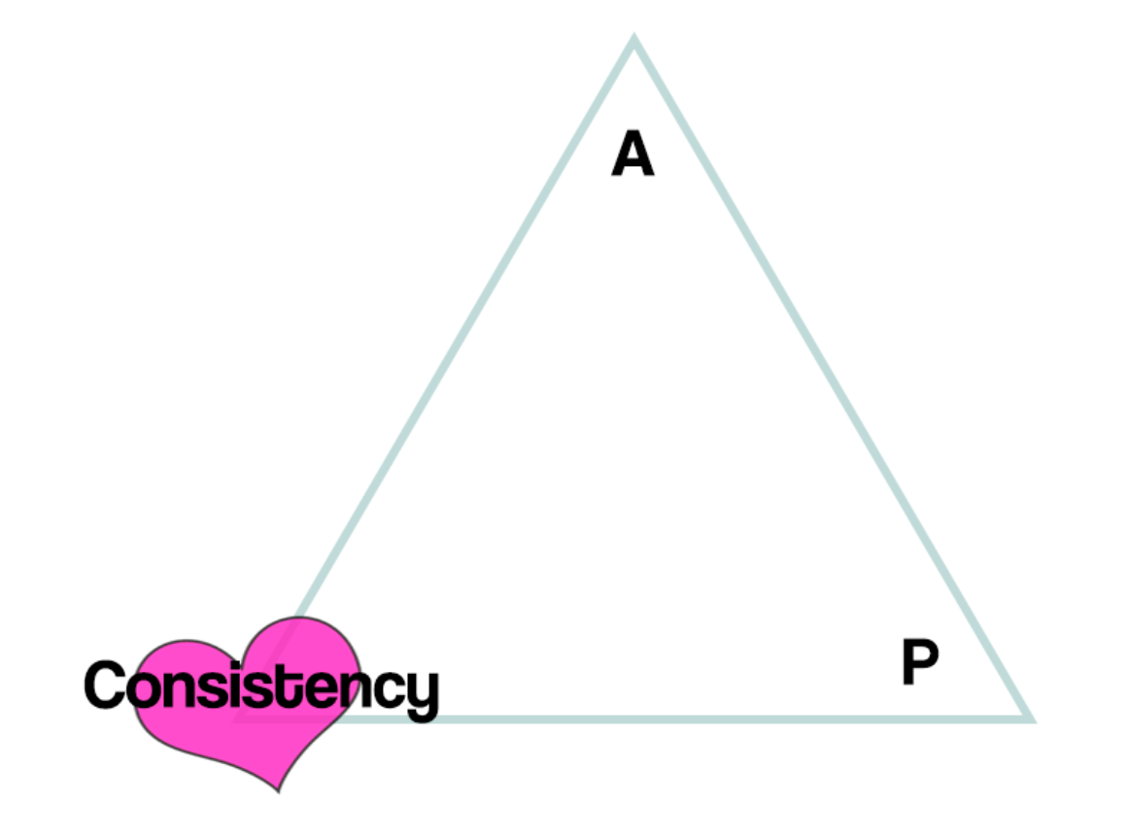
Relational DB
Don’t scale horizontally very well
Designed for ACID instead of BASE
Shredding is inefficient
Writing dynamic ANSI SQL is the pits
Notes:
Relational database aren’t optimized for searching
Atomicity, Consistency, Isolation, Durability
Basic Availability, Soft State, Eventual Consistency

Slide 4
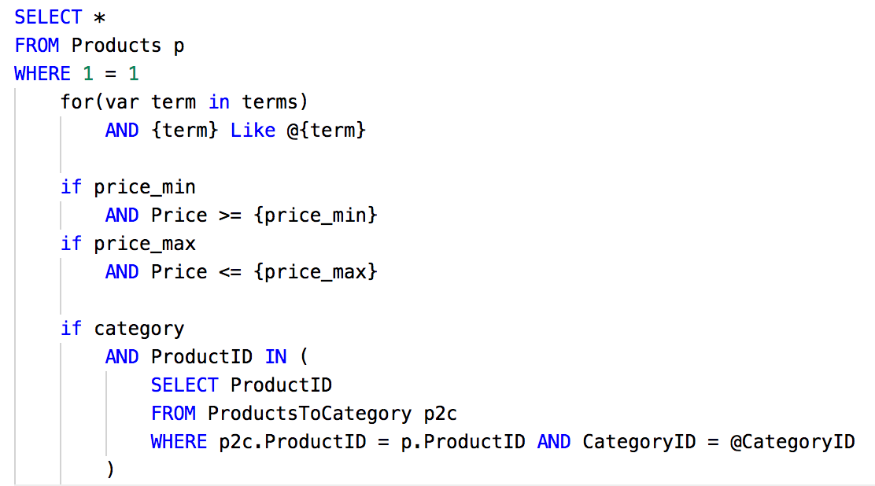
It starts out innocently enough
Notes:
Ever written code like this?
It starts out innocently enough, just a simple like search. Then you start searching other fields.
Next thing you know you’re dynamically adding joins, and creating temp tables, group by, LIST_CONCAT, CTE
You’ve got if statements for this and for that…and if you’ve got paging, and need to support multi-page actions…

Slide 5
When your query is still running after 2 minutes and you see your face reflected in the IDE

Slide 6
Reverse Index Search
NoSql DB: Horizontal Scaling
DeNormalize our data
Index everything!
Map/Reduce to search quickly
Declarative language
Notes:
So…why don’t we use a nosql implementation denormalize the heck out of, and then index the heck out of it, then map reduce the heck out of it – Well… you just described a reverse index search engine!

Slide 7
Reverse Index Search Engines
Reverse Index Database
Slow to Write, Fast to Read
NoSql before it was called NoSql
Scale Super Well
Wicked Fast
Support Complex Filters

Slide 8
Reverse Index Search
Notes:
Index all the important stuff, point

Slide 9
English is complicated!
Stop words: “the”
Synonym: PWA = “Progressive Web Apps”
Stemming: run, runs, ran, running
Lots, lots more
Notes:
Ever written code like this?
It starts out innocently enough, just a simple like search. Then you start searching other fields.
Keep adding if statements to the main query...
And anywhere you're doing aggregations
And any time you take batch action...

Slide 10







Elastic Stack
Notes:
Open source…ish
NoSQL before NoSQL
Built on Lucene
Azure search, AWS cloud search also built on Lucene

Slide 11
Complex Declarative Queries
REST API
Declarative Syntax

Slide 12
What can I build?
Free text search
Aggregation and Filtering
Logger/APM

Slide 13
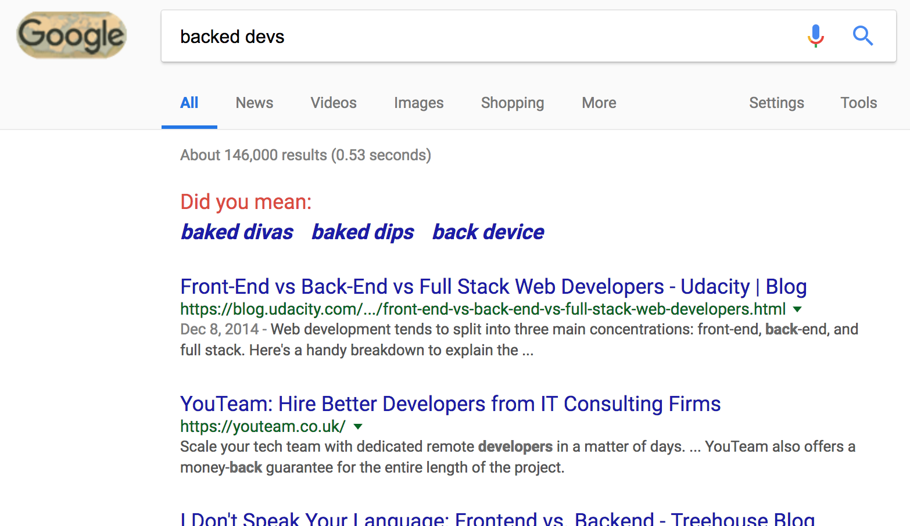
Full Text Searching

Slide 14




Aggregations
Notes:
80,000 for “camera’

Slide 15
Application Performance Management (APM)
Notes:
Splunk DataDog
Difference here is
Windows 2012
Python 2.7

Slide 16
Logstash loads data
Python/Flask for users
APM X-Pack Plugin for monitoring
Kibana for Administration Elasticsearch for everything

Slide 17
Search Driven Apps
with the Elastic Stack
Notes:
ElasticSearch is a highly scalable and feature-rich search engine that makes certain types of problems very easy to solve. I will show you how Elasticsearch approaches these problems and then demonstrate 3 different types apps that make good use of this approach.

Slide 18
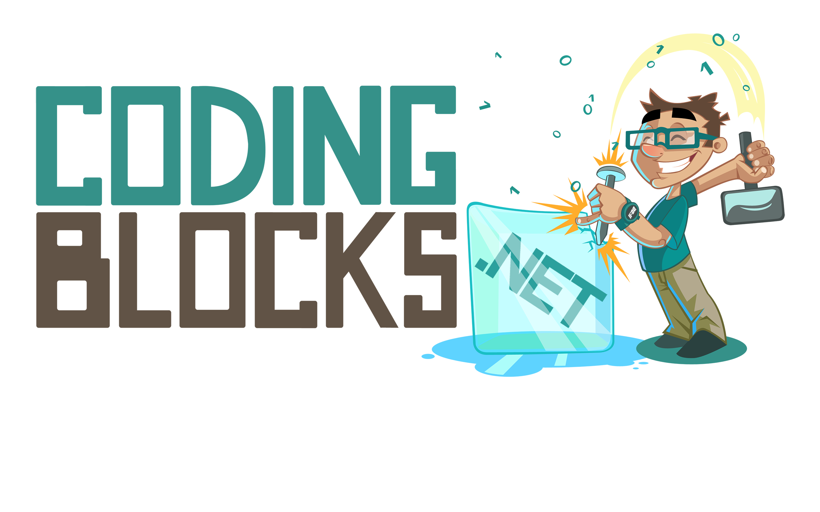
Like this talk? Check out the show!
Joe Zack
@codingblocks
Notes:
We speak with 10’s of thousands of programmers every month who want to get better
Take lessons from modern research and other fields and apply them to programming as yet another way to learn

